Slide 1

Bank Loan Analytics
Presented By Group 4 - (05-September -2024)

Slide 2

MEET THE TEAM MEET THE TEAM MEET THE TEAM Meet the team
01
Kiran Mishra
Sharon Dass
02
Sharon Dass
Kajal Bile
Kajal Nichal
03
Kajal Bile
04
Srihari T
05
Shambhavi Joshi
06
Drashti Nimavat

Slide 3
Introduction Purpose Scope KPI’s insights
01
AGENDA
02
03
04
05

Slide 4
INTRODUCTION
Our presentation today will walk you through a detailed examination of the data, insightful observations, and actionable recommendations for stakeholders in the financial industry.
We believe that data-driven insights are instrumental in making informed decisions, reducing risks, and ensuring the overall health and sustainability of the banking sector.

Slide 5
SCOPE
The scope of this analysis encompasses a multifaceted exploration of loan data, including year-wise loan amounts, grade and sub-grade-wise revolving balances, total payments based on verification status, state-wise and month-wise loan status, and the relationship between home ownership and last payment dates.
By scrutinizing these KPIs, we aim to uncover trends, patterns, and correlations that can drive better lending practices, risk management, and financial planning.

Slide 6
Overview
As per the data 39,717 number of Bank Customers. We are using different types of categories to analyze the data and find out the verified and non-verified customer based on year and interest. How payment mode is effected in loan section.
Methodology:
The Research conducted a quantitative analysis on data and data set gotten from EXCELR.

Slide 7
Tools
EXCEL
PROJECT MANAGEMENT TOOLS
POWER BI
TABLEAU
My SQL

Slide 8
INCEPTION OF DATA
Total Number of Loan Accounts
39717
Total Loan amount
$445,602,650
Loan Tenure
36 & 60 Months
Average Interest Rate
12.02%
Total Revolutionary B alance
39717

Slide 9

KPI’s Key performance indicators

Slide 10
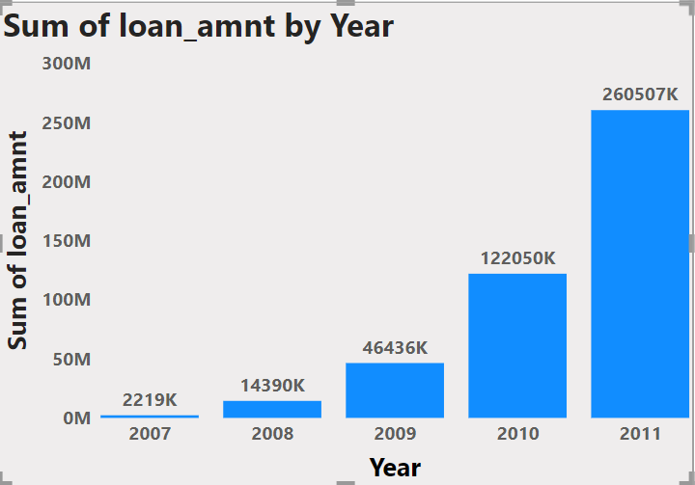
KPI 1:-
Our Analysis Suggests that The Total Loan amount was increased year by year &
2011 boosts the highest loan amount while 2007 reflects the lowest amount.

Slide 11
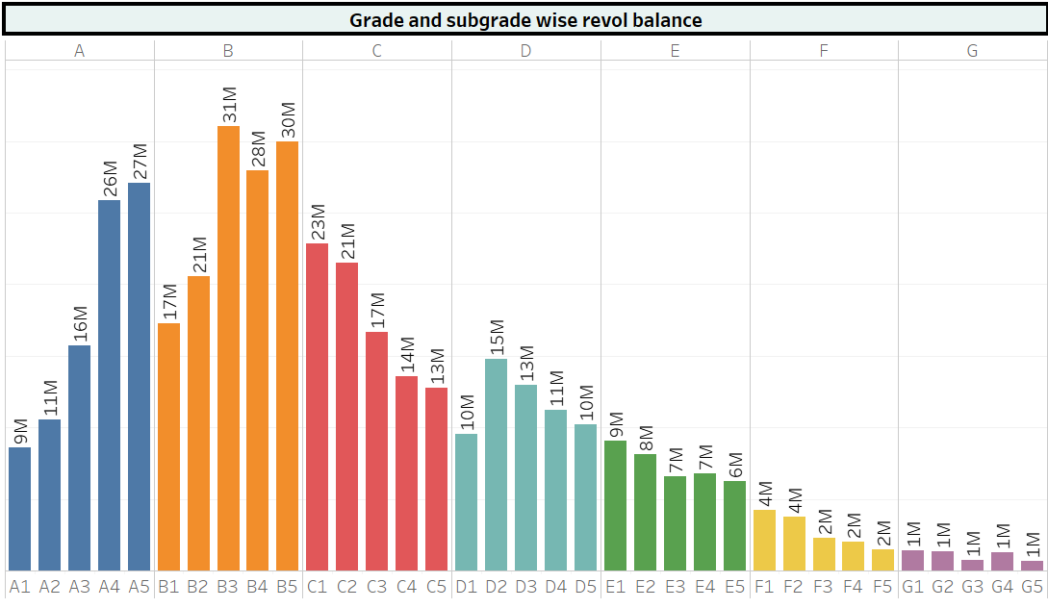
KPI 2:-
Revol _Balances in Grade B are favorable compared to other grades. Actions should be taken regarding Grade G. This Analysis Supports effective Risk Management, credit decision-making, monitoring of the bank’s credit quality.

Slide 12
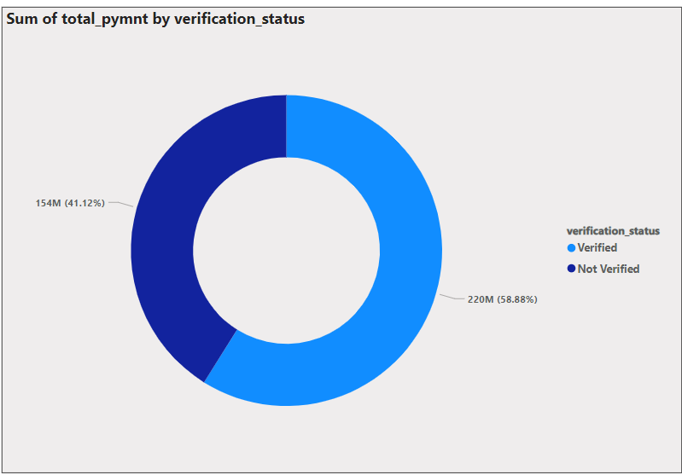
KPI 3:-
As we Can see in the Donut Chart that Out of 373 Million only 59% are verified i.e 220 million.
41.12% of 373 Million are not verified i.e. 154 Million.
Which might be a threat to company, Should inform the verification team to take required action regarding that.

Slide 13
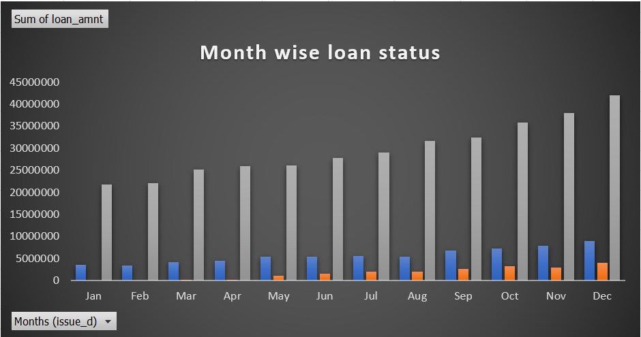
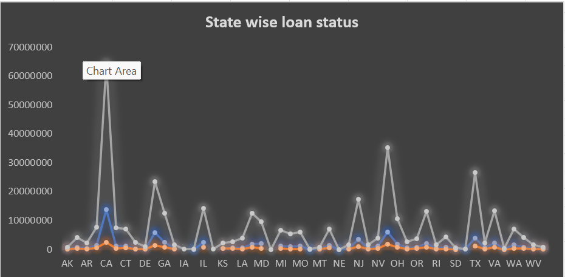
KPI 4:-
By Detail Analysis ,we conclude that, CA state has top fully paid loan status. Current we have 154. We need to act on the charged off items.

Slide 14
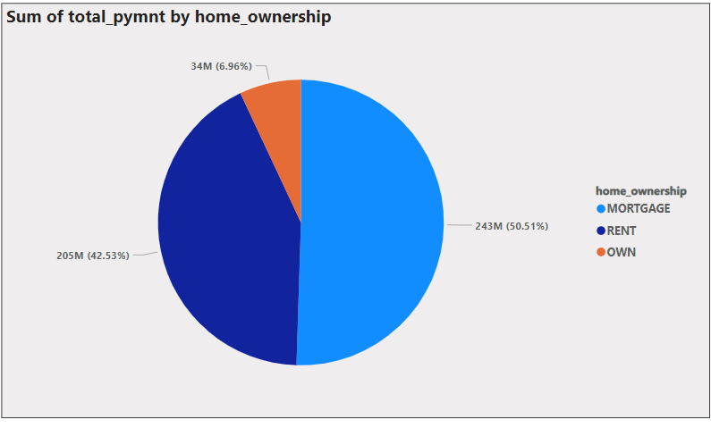
KPI 5:-
We provide three distinct categories of home ownership. Up until 2011, the 'Rent’ Have held the highest loan amount among them, but 'Mortgage' has consistently maintained the highest loan amount since then

Slide 15

DASHBOARD

Slide 16
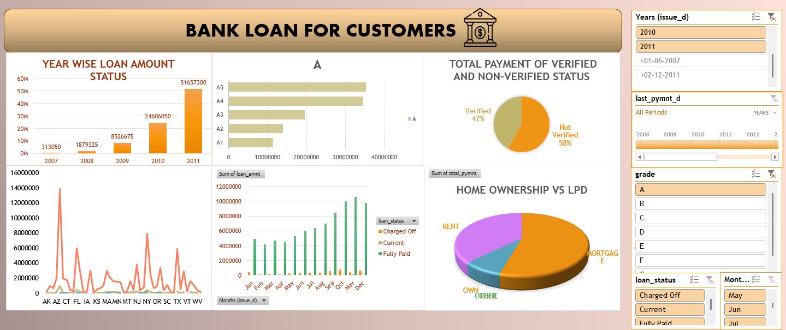
EXCEL DASHBOARD

Slide 17
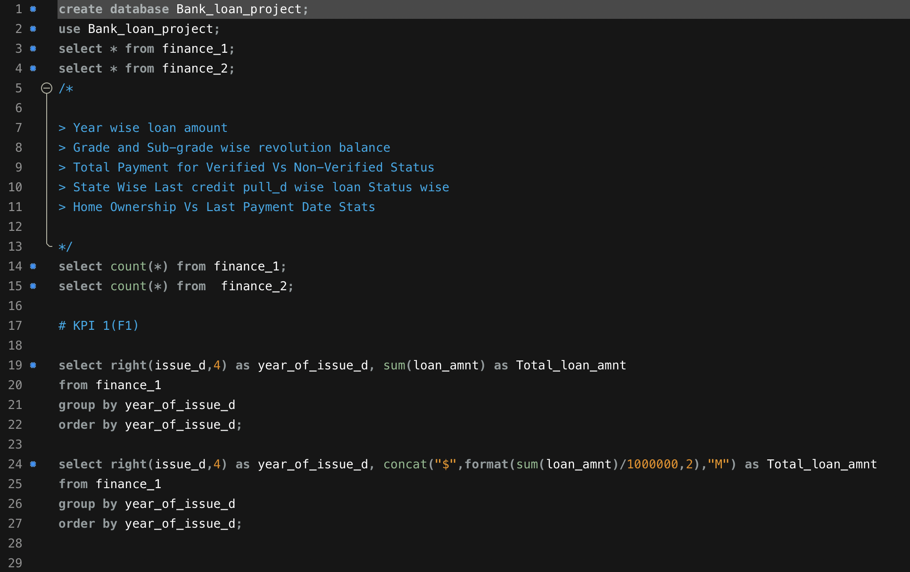
MySQL DASHBOARD

Slide 18
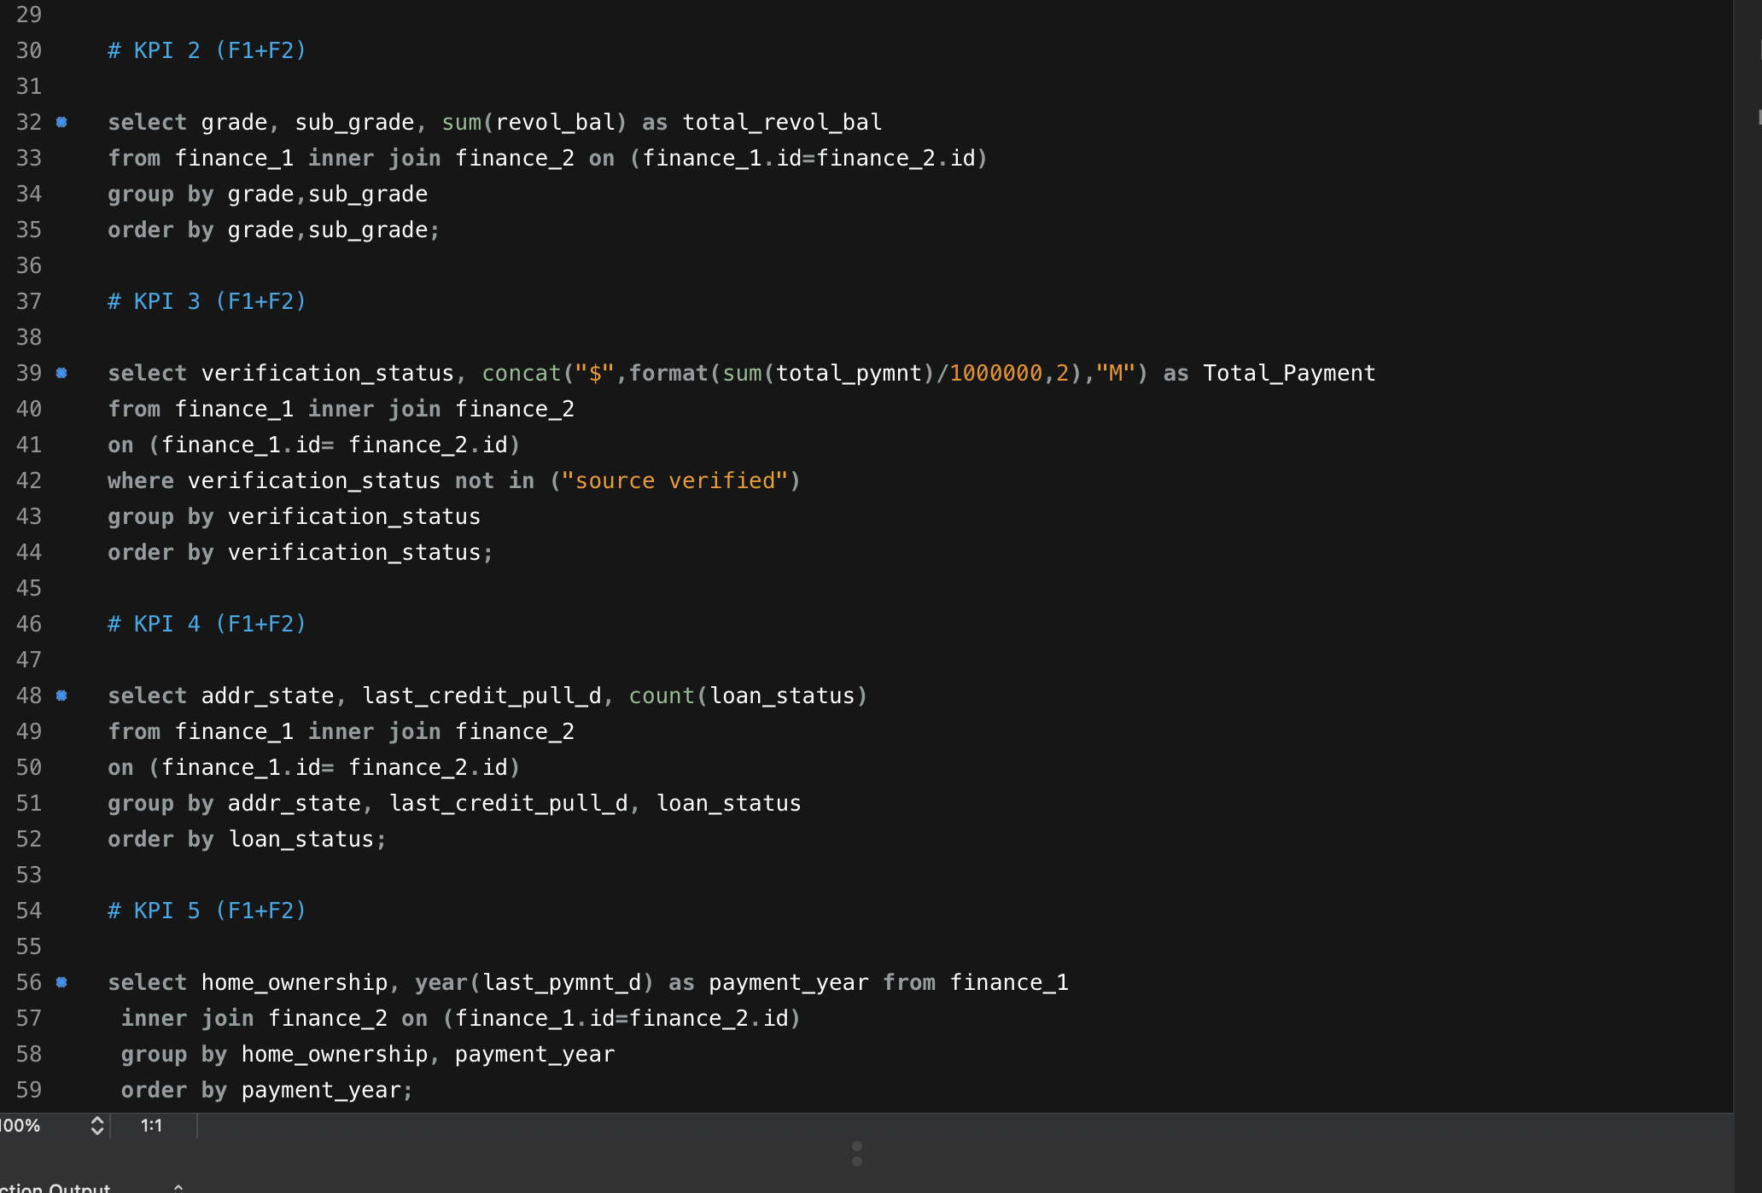

Slide 19
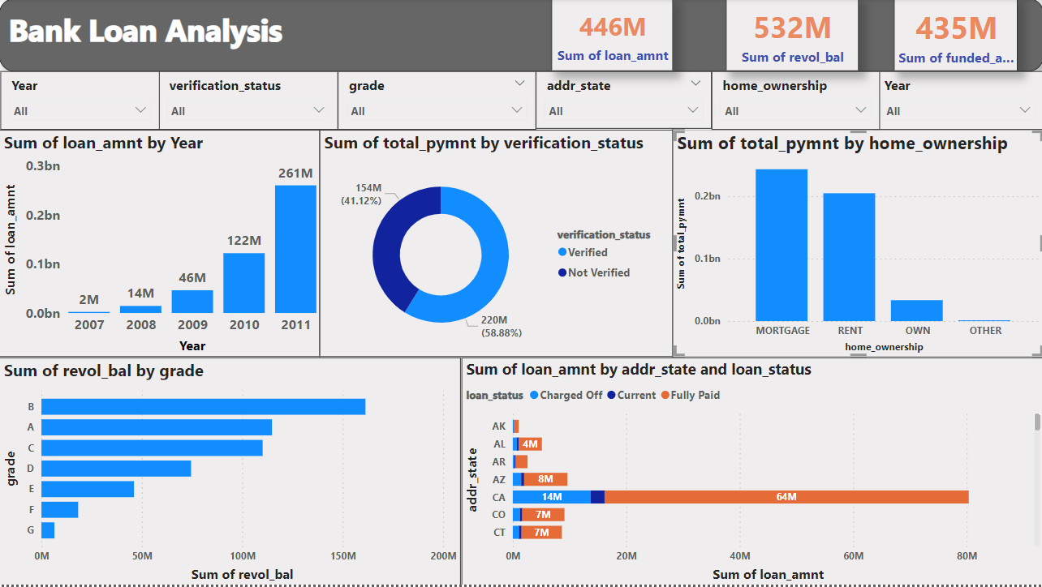
Power bi DASHBOARD

Slide 20
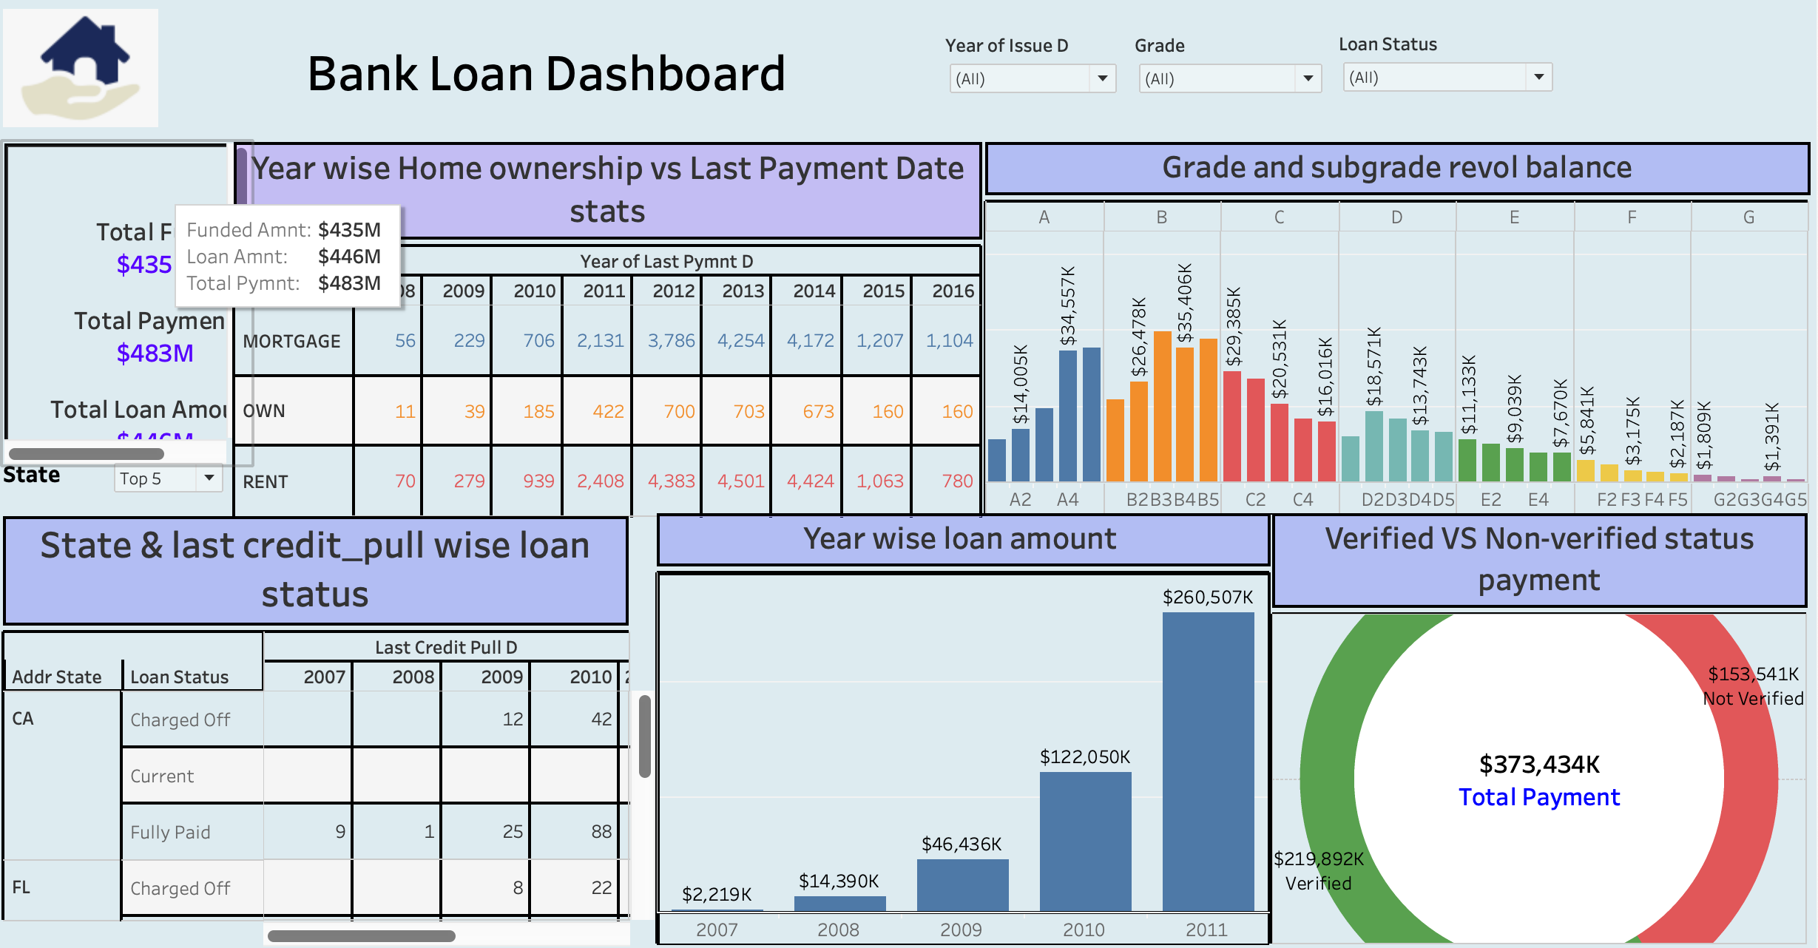
Tableau DASHBOARD

Slide 21
INSIGHTS
The increase in loan amounts signifies a growing credi demand.Growing loan amounts indicate borrowers' increased willingness to seek financing for various needs.
Following closely is the "Charged Off" category, indicating a substantial number of loans declared as losses.
Subgrade B3 within Grade B holds the highest revolving balance, amounting to 39.7 million.
This data underscores the importance of verification in facilitating higher payment volumes and potentially enhancing trust and security in financial transactions.
The data highlights the significance of mortgage loans in the housing market due to their higher loan amounts compared to other home ownership categories. Analyzing the last payment date aids in assessing payment timeliness and potential repayment patterns within each home ownership category."

Slide 22
THANK YOU

